Slide 1
JIT & AOT Compilers

Slide 2
What you’ll learn
Compilers vs Interpreters
How “write once run everywhere” helped Java dominate
LLVM
What a JIT Compiler is
Limitations of AOT

Slide 3
Terminology
Compiler -
translates a source language to another language (usually a lower level language)
Interpreter -
takes in source code and executes in immediately

Slide 4
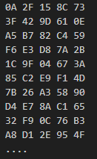
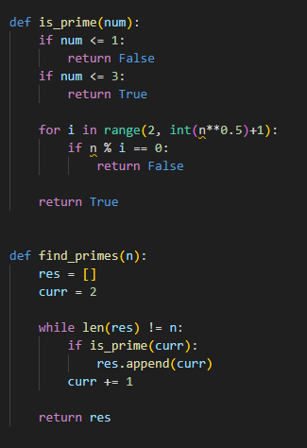
Compilation illustration
.exe

Slide 5
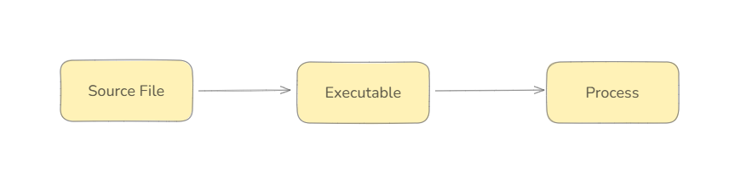

Compiler vs Interpreter workflow
Compiler
Interpreter
Notes:
Like most things in life, there’s a tradeoff to everything
Can anyone from the audience identify the tradeoff here?
Execution speed vs Compilation speed

Slide 6
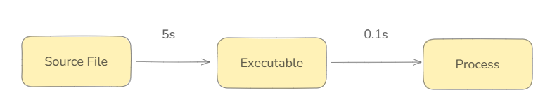

Interpreters being faster than compilers

Slide 7
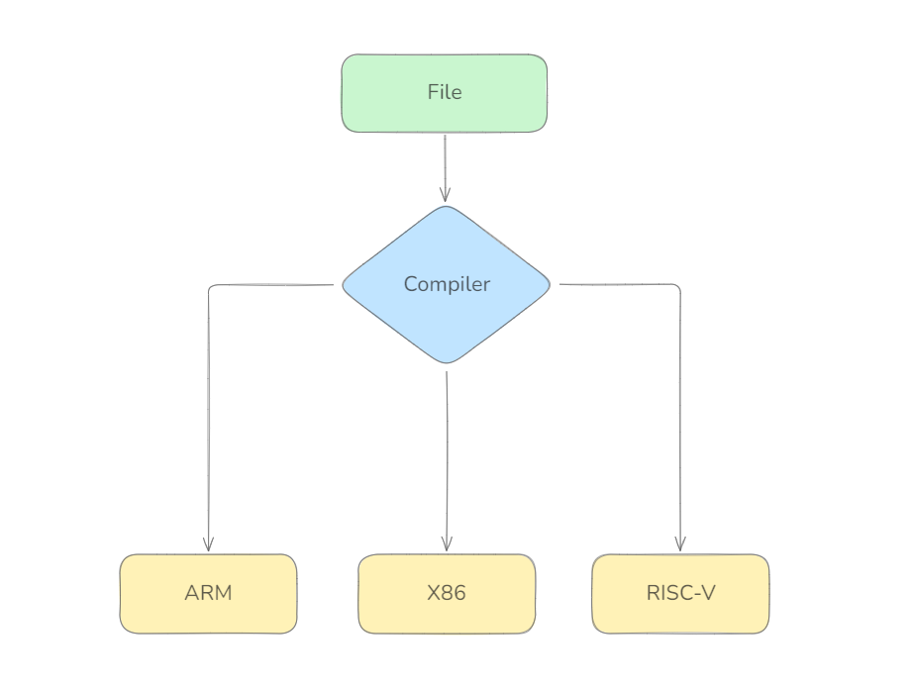

Slide 8

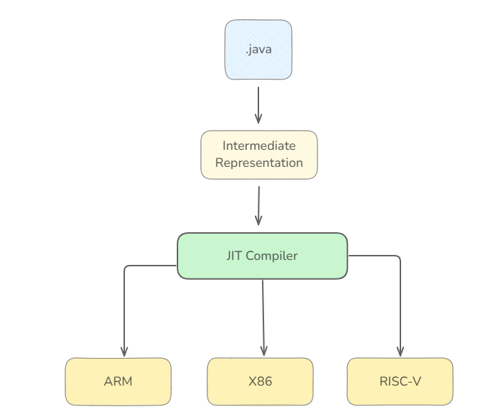

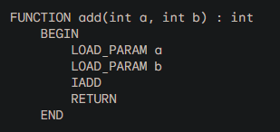
“Write once run everywhere”

Slide 9



LLVM
Modular & Reusable compiler and toolchain technologies
LLVM IR
IR Optimization
Code Generation
Notes:
Haskell, Julia, Rust, Swift, D, Ada, CUDA

Slide 10
Writing a new language
.xt
LLVM Toolchains
LLVM IR
Machine Code Generation
Notes:
Haskell, Julia, Rust, Swift, D, Ada, CUDA

Slide 11
What’s a JIT Compiler?
Runs the bytecode (IR)
Identifies the frequently used parts (like loops), compiles then into native machine code, and swaps them
Compiled bits now executes faster
Combines speediness of directly interpreting and execution speed of natively compiled code
Best of both worlds!
Notes:
Talk about startup time for JIT compilers before it starts identifying “hot areas” and compiling them

Slide 12
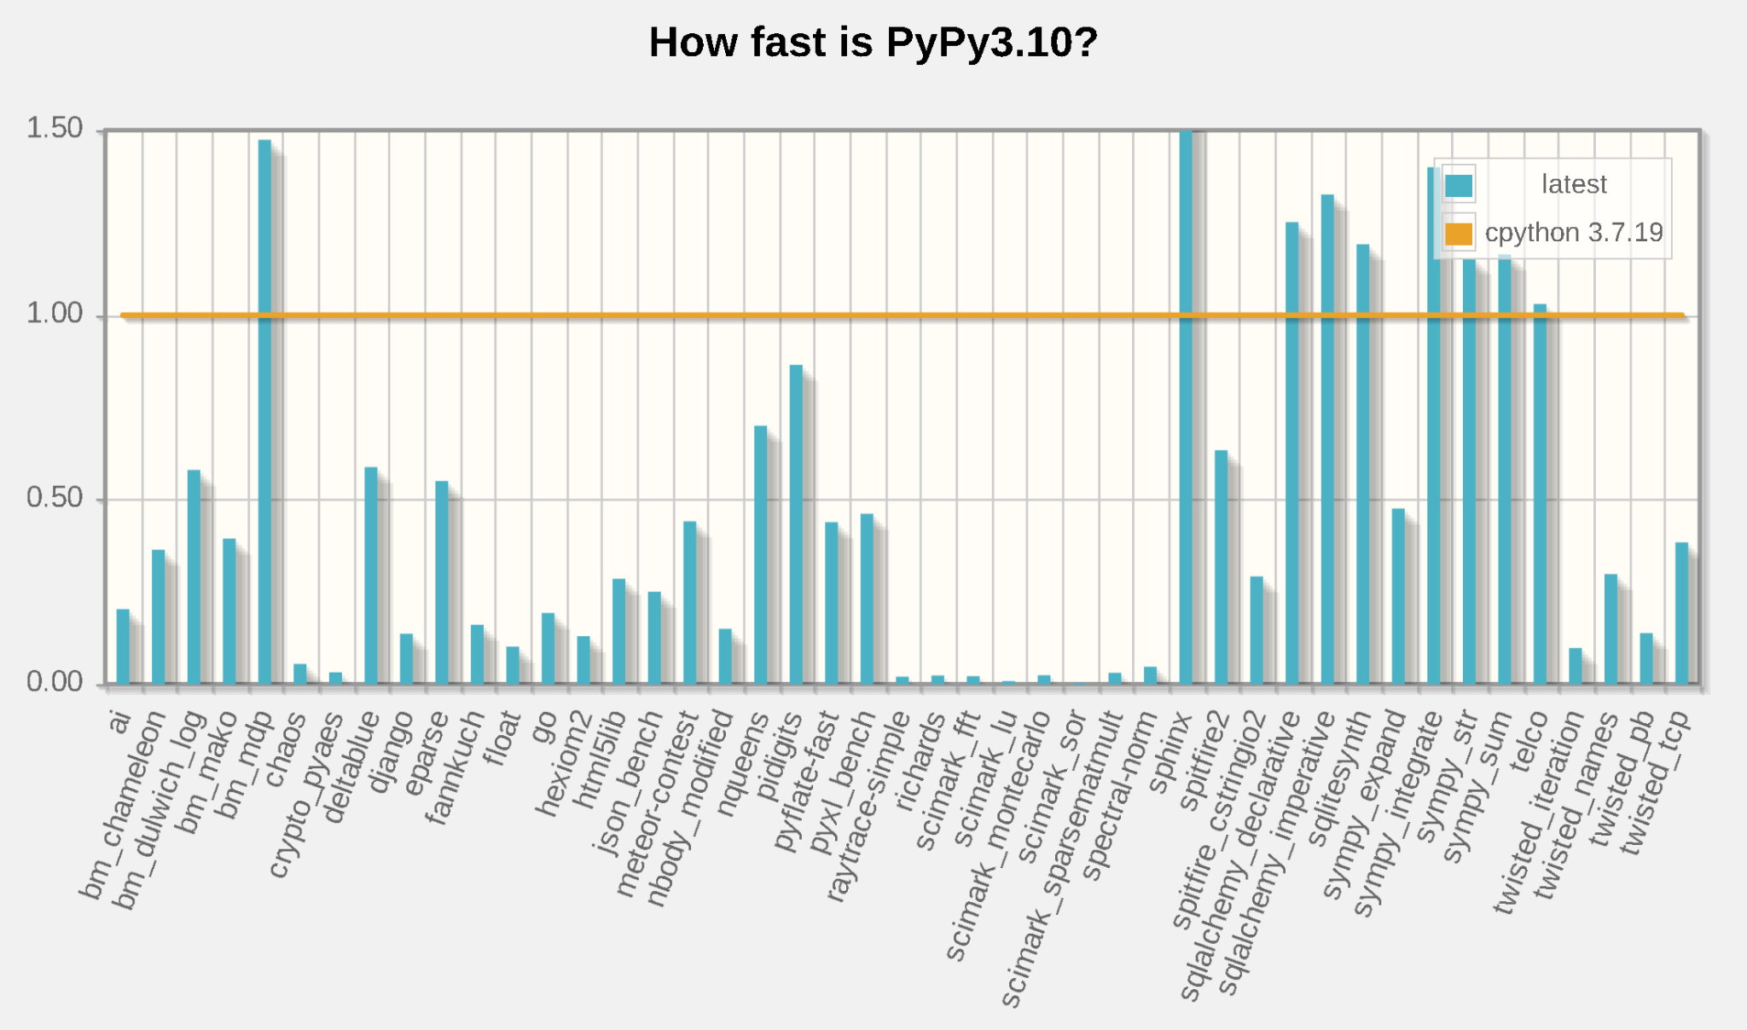
CPython vs PyPy

Slide 13
Using AOT with Java (GraalVM)
Yes, your app’s will start up in milliseconds but…
Anything with dynamic loading won’t work (e.g. reflection, JNI, dynamic proxies, etc.)
Libraries that you use will need to be AOT ready
Spring’s @Profile & @ConditionalOnProperties won’t work

Slide 14
Key Takeaways
Compilation Speed vs Execution Speed Tradeoff
JIT Compilers combining both approaches
IRs & how Java does “Write once run everywhere”
Considerations when using AOT in Java
Notes:
Mention further readings, things like reflection JNI and proxies not being available in AOT compilation
Libraries that you want to use needs to be AOT ready

